Slide 1

Railway Management System

Slide 2
Introduction:
A railway management system is a software application that helps manage various operations and processes related to railways. This can include tasks such as scheduling trains, managing ticketing and reservations, maintaining equipment and infrastructure, and analyzing data to improve efficiency and performance.
The main objective of a railway management system is to streamline and optimize various processes involved in the operation of a railway network. It helps reduce costs, improve customer satisfaction, and increase the overall efficiency of the railway system.

Slide 3
AIM:
The aim is to design and develop a database maintaining the records of different trains,passengers, tracks, stations, schedule and routes.
Apart from reserving tickets, through our system a passenger can compare online fares ‘from’ various cities ‘to’ various cities.
Optimizing and streamlining various processes involved in the operation of a railway network. This can help reduce costs, improve customer satisfaction, and increase the overall efficiency of the railway system.

Slide 4
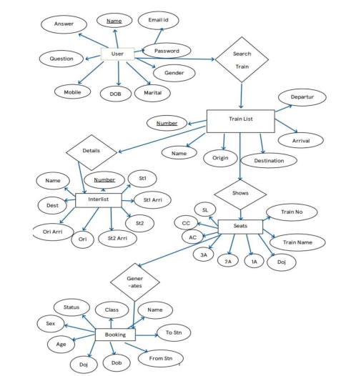
ER Diagram:

Slide 5
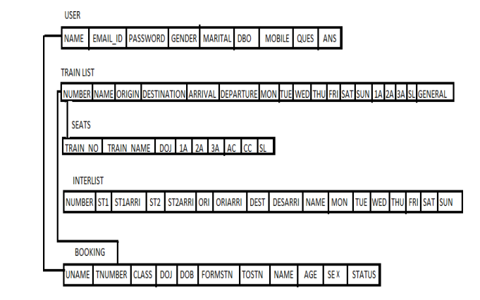
Schema Diagram:

Slide 6
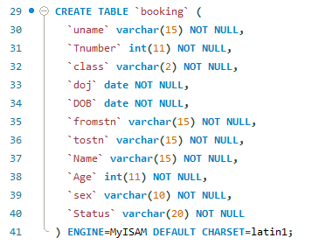
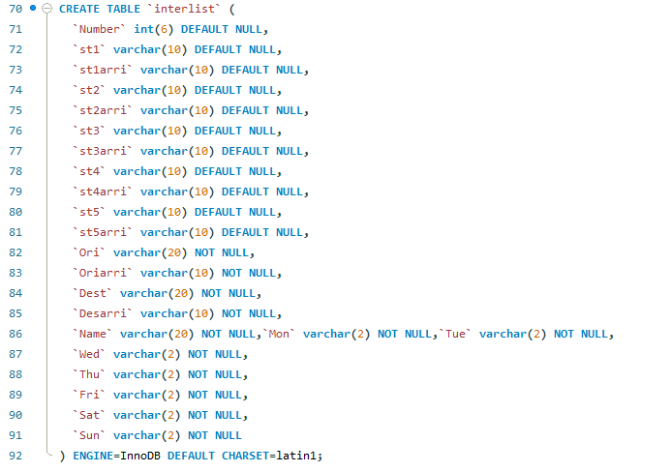
List of Entities:

Slide 7
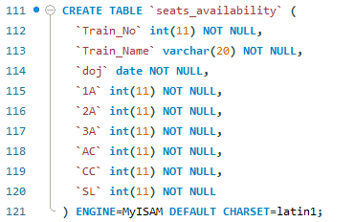
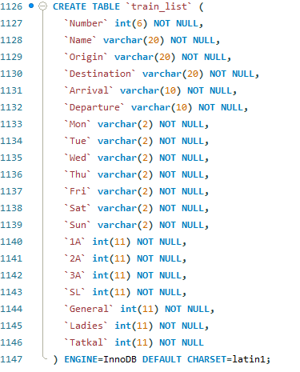
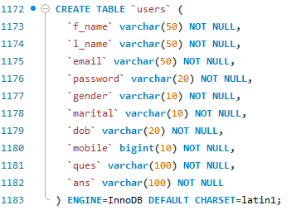
List of Entities: (Cont)

Slide 8
Detailed Description:
RAILWAY RESERVATION SYSTEM should be able to manage all the reservation related functions. The system should be distributed in nature. This system is divided into five zones.
Each zone should have same functionalities. Each zone will stores the information about train name, train schedules, availability. The administrator should be able to enter any change related to the train information like change in train name, number etc. The system should be able to reserve seat in a train for a passenger. First the clerk will check for availability for the seats in a particular train on a specified date of journey. If it is available the clerk will reserve seats. The passenger will be given a unique PNR no. The system should be able to cancel a reservation. The clerk will delete the entries in the system. The passenger can check their reservation status online by entering their PNR no. The system will display his current status like confirmed, RAC or waiting list. They are also able to see information related to the train schedules.
The system should be able to print the report like it should be able to generate reservation chart, train report, reservation ticket which will have train no and name, date of journey, boarding station, destination station, person name, age, [censored], total fare and a unique PNR no. The system should be able to print the cancellation ticket which will have total fare and the amount deducted.

Slide 9
Front End We Used:
HTML: HTML is used to create and save web document. E.g. Notepad/Notepad++
CSS : (Cascading Style Sheets) Create attractive Layout
Bootstrap : responsive design mobile friendly site
JavaScript: it is a programming language, commonly use with web browsers.

Slide 10
Back End We Used:
PHP: Hypertext Preprocessor (PHP) is a technology that allows software developers to create dynamically generated web pages, in HTML, XML, or other document types, as per client request. PHP is open source software.
MySQL: MySql is a database, widely used for accessing querying, updating, and managing data in databases.
Software Requirements: (Any one of)
WAMP Server
XAMPP Server
MAMP Server
LAMP Server

Slide 11
Conclusion:
A railway management system project in a database management system (DBMS) would involve the development and implementation of a database to store and manage information related to the operation and management of a railway network. This could include data on trains, schedules, routes, infrastructure, maintenance, and other important aspects of railway operations.
The use of a DBMS would enable efficient storage, retrieval, and analysis of this data, enabling railway operators to make better-informed decisions and optimize their operations. A railway management system project in a DBMS could also involve the integration of other systems and technologies, to provide a more comprehensive and holistic view of the railway network.
Overall, the implementation of a railway management system project in a DBMS can bring significant benefits to railway operators, including increased efficiency, safety, and customer satisfaction. However, it is important to carefully consider the costs and resources required to develop and maintain such a system, and to ensure that it is well-suited to the needs and operations of the specific railway.

Slide 12
Team Details:
Venkata Naga Kalyan Puppala - AP20110010509
Bhargav Sai Rohith T - AP20110010529
Vyshnavi Yakkanti - AP20110010559
Sreeya N - AP20110010516

